Slide 2
FOR INFORMATION (take a pic of this slide)
www.cosaction.com
maurice.emmer@cosaction.com
(415) 806-0592
(phone and text)
Notes:
At this website you can get a wealth of information
You even can sign the petition to your legislators

Slide 3
WHAT IS A CONVENTION OF STATES?
An assembly of delegations from the states. Colonies and states used conventions:
To establish rules for dealing with each other (e.g., interstate taxation, water rights)
To propose amendments to state and federal constitutions
To ratify amendments proposed either by a legislature or a previous convention
Notes:
CONVENTIONS, OR “ASSEMBLIES” ARE GATHERINGS OF DELEGATIONS SENT BY STATE LEGISLATURES EITHER TO PROPOSE RULES OR TO RATIFY RULES PROPOSED BY ANOTHER BODY
THEY’VE BEEN USED TO PROPOSE OR RATIFY RULES GOVERNMING INTERSTATE MATTERS
THEY’VE BEEN USED TO PROPOSE CONSTITUTIONAL AMENDMENTS
THEY’VE BEEN USED TO RATIFY A CONSTITUTIONAL AMENDMENT

Slide 4
REVOLUTIONS
LEADING TO
SELF GOVERNMENT

Slide 5
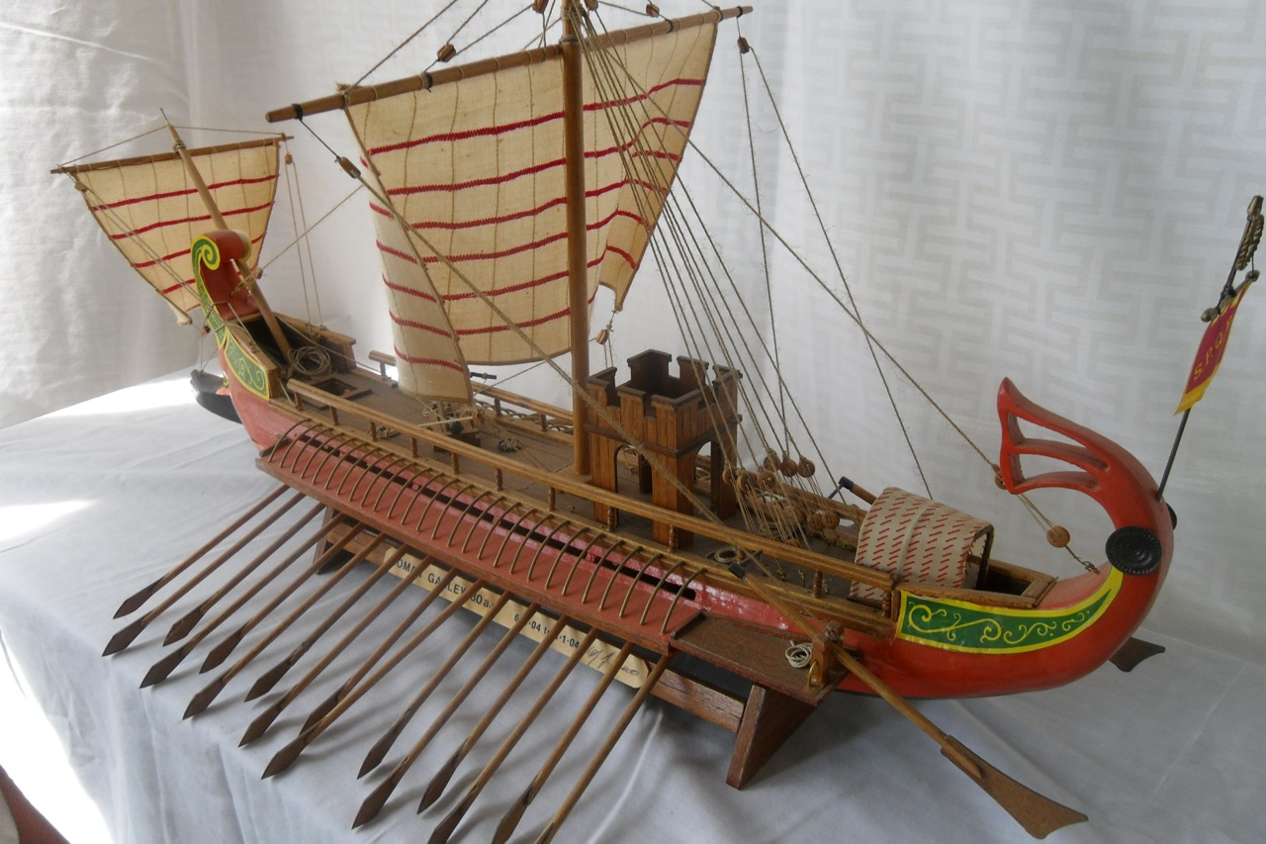
THE ENGLISH/AMERICAN MIRACLE
Human society before the English Revolutions (350,000 years)
Tribal, authoritarian, classist, hostile to innovation, wretched living conditions (homo sapiens likes leaders)
Notes:
We believe homo sapiens emerged about 350,000 years ago.
For 99.8 percent of the time since homo sapiens emerged (that is, until about 700 years ago) life was just as Thomas Hobbes described it: “solitary, poor, brutish and short.” There was little technological innovation. Monarchy was the standard form of government. A few wealthy people lived relatively well, but most people lived in squalor.
But, in England, some nobles became unhappy with following the leader’s commands without limits. They rebelled from time to time.
Eventually the king and the nobility reached a treaty placing limits on the king’s authority over them.
That was a key development.

Slide 6
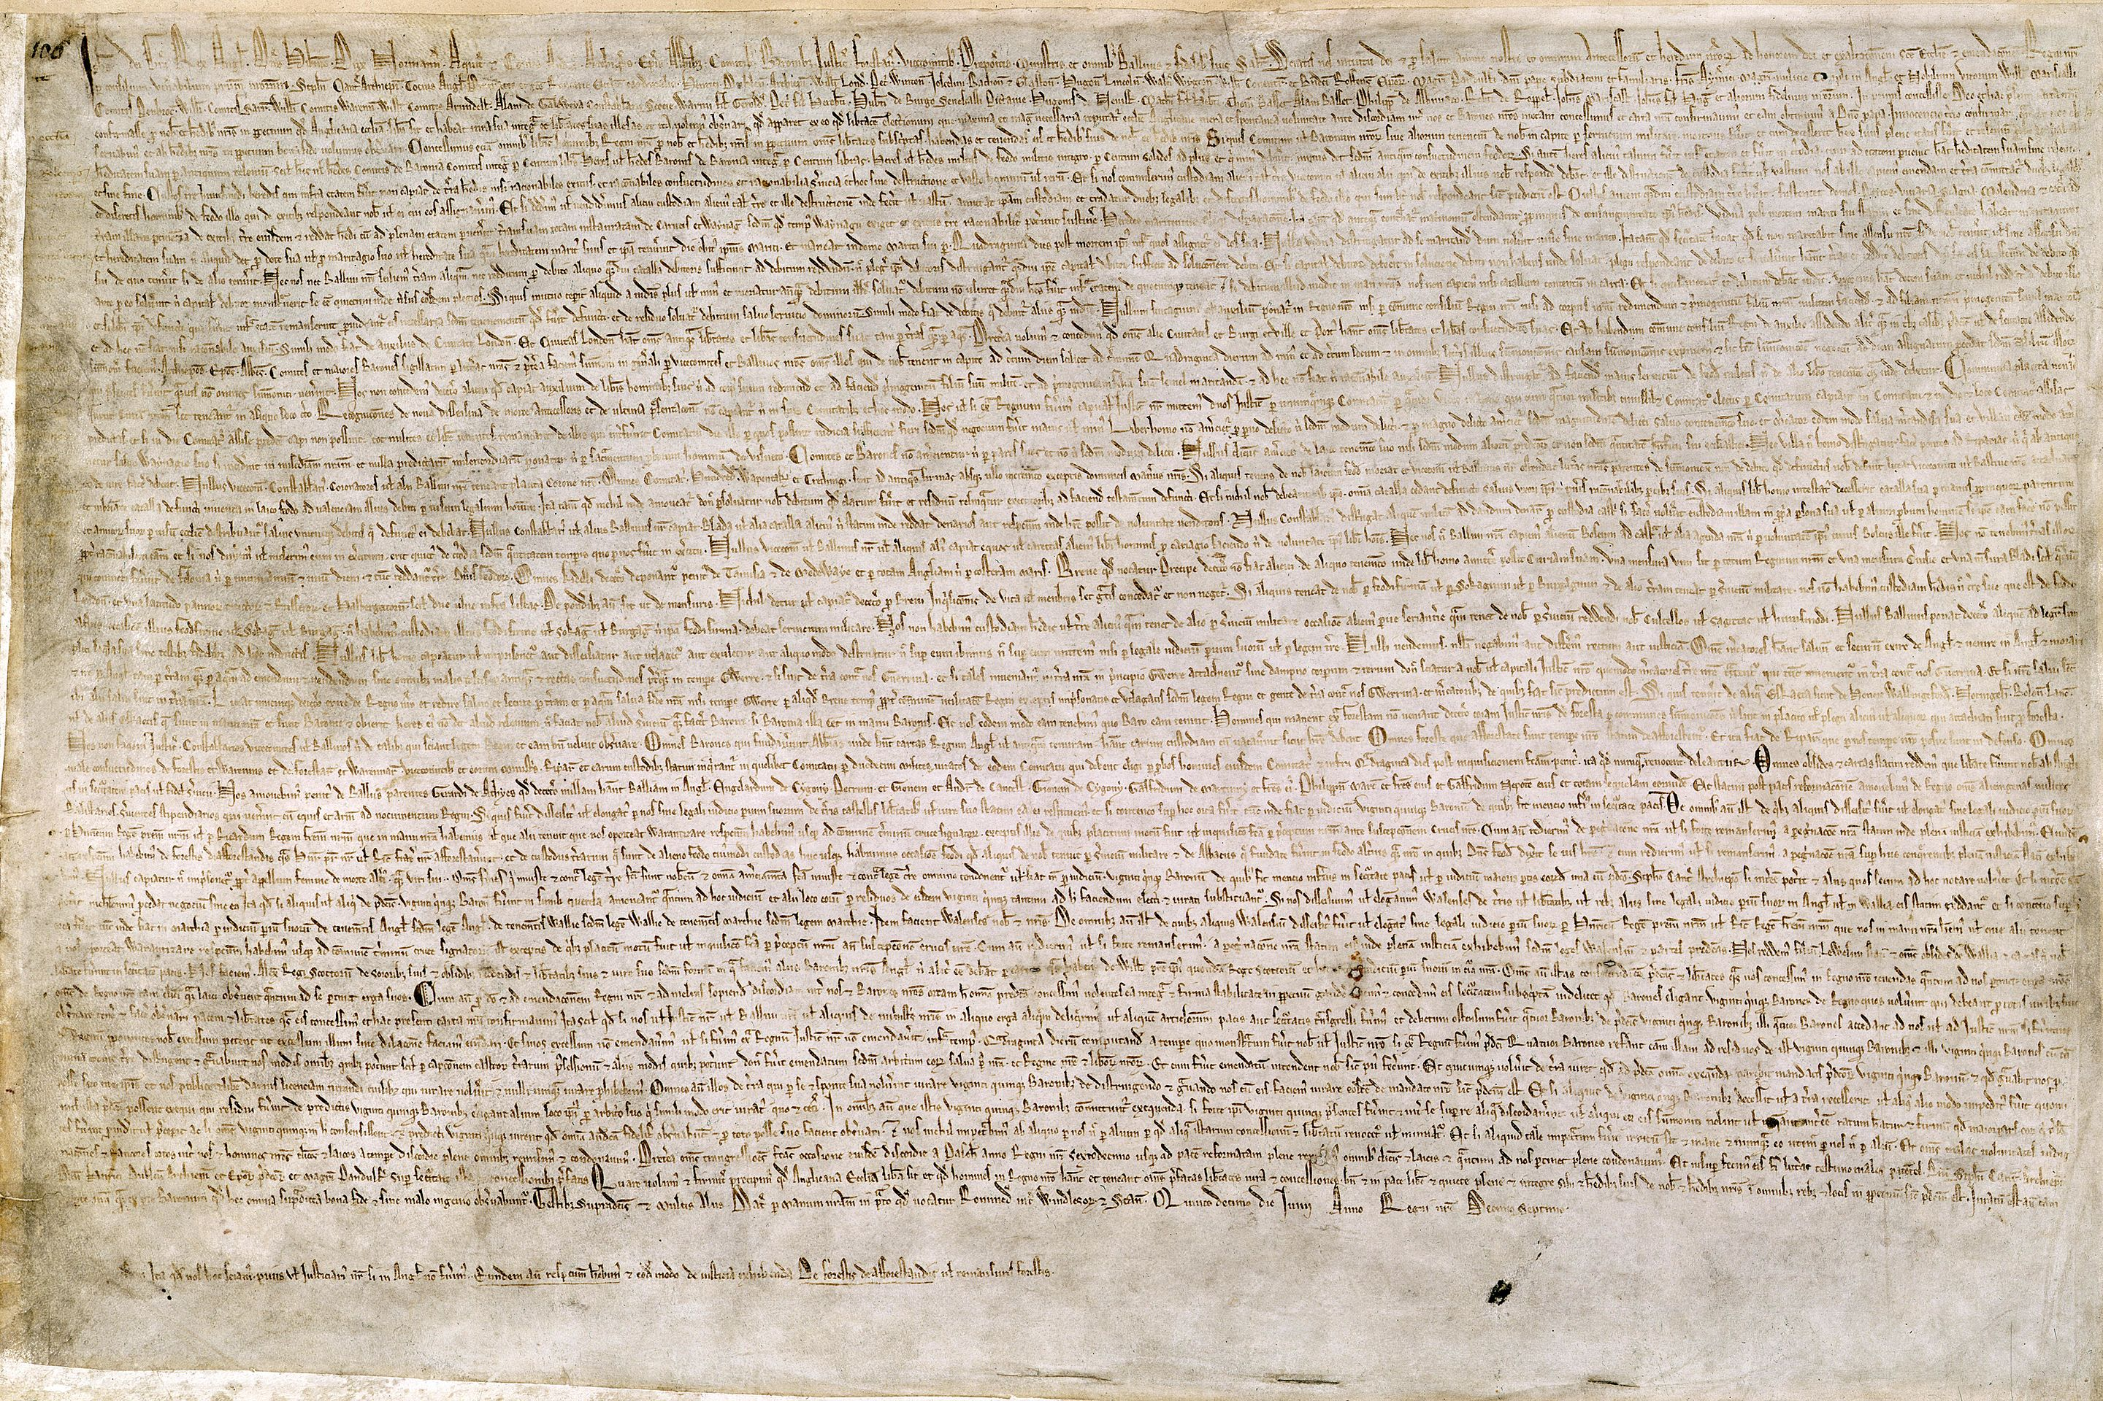
1215 A.D.-MAGNA CARTA LIBERTATUM (GREAT CHARTER OF LIBERTIES) SEPARATION OF POWERS IS BORN
Notes:
In 1215, A.D. the English king agreed to a written contract that limited his powers: THE MAGNA CARTA LIBERTATUM. THE GREAT CHARTER OF LIBERTIES
This was revolutionary as it acknowledged a SEPARATION OF POWERS between the central authority (the king) and the regions of England (governed by the nobility)
It also was revolutionary in the sense it was written down, so there was a document that could be referred to later when there would be disputes over the boundaries of authority between central and regional governance.

Slide 7
ENGLISH REVOLUTIONS REFINED SEPARATION OF POWERS
1225 A.D. THE MAGNA CARTA
1625 CHARLES I NEUTRALIZED PARLIAMENT
1642 ENGLISH CIVIL WAR REESTABLISHED PARLIAMENTARY POWER (OLIVER CROMWELL)
ENGLISH BILL OF RIGHTS
1685 JAMES II ATTEMPTED TO NEUTRALIZE PARLIAMENT AND INSTALL ROMAN CATHOLICISM IN PLACE OF CHURCH OF ENGLAND
1688 THE “GLORIOUS REVOLUTION” INSTALLED WILLIAM (OF ORANGE) AND MARY, REESTABLISHED PARLIAMENT, AND PRODUCED THE ENGLISH DECLARATION OF RIGHTS
OUR FOUNDERS KNEW THIS ALL VERY WELL
Notes:
THE CONCEPT OF DIVIDED POWER GREW FROM THE MAGNA CARTA. EVENTUALLY IT WAS WELL ESTABLISHED THAT THE SOVEREIGN (KING OR QUEEN) DIDN’T HAVE UNLIMITED POWER. SOME POWERS BELONGED TO PARLIAMENT. AND BECAUSE PARLIAMENT REPRESENTED THE PEOPLE, THOSE POWERS ULTIMATELY BELONGED TO THE PEOPLE.

Slide 8
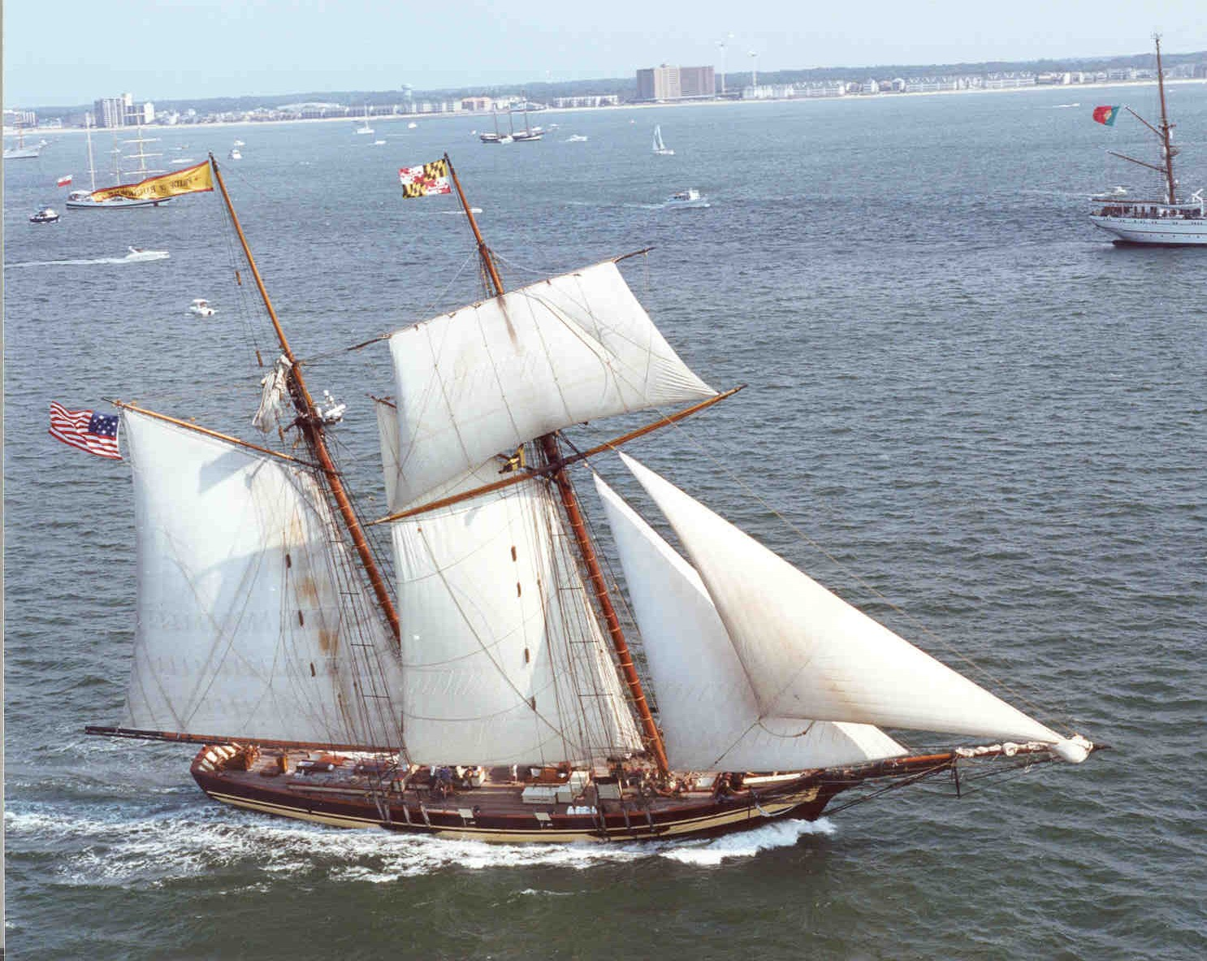
SELF GOVERNMENT BLOSSOMS
Human society after the English Revolutions (the last 300 years)
Separation of powers, e.g., King vs. Parliament
Constitutional government
Industrial revolution; embracing innovation
Rapid innovation in all fields
Unprecedented prosperity
The Miracle of America
Notes:
SEPARATION OF POWERS AND RECOGNITION OF FUNDAMENTAL RIGHTS OF THE PEOPLE LED TO AN EXPLOSION OF PROSPERITY.
IT LED TO THE INDUSTRIAL REVOLUTION
WHICH LED TO UNPRECEDENTED PROSPERITY
WHICH LED TO THE MIRACLE OF AMERICA

Slide 9
UNIQUENESS OF ARTICLE V
“The Congress, whenever two thirds of both Houses shall deem it necessary, shall propose Amendments to this Constitution, or, on the Application of the Legislatures of two thirds of the several States, shall call a Convention for proposing Amendments, which, in either case, shall be valid to all intents and purposes, as part of this Constitution, when ratified by the Legislatures of three fourths of the several States, or by Conventions in three fourths thereof as the one or the other mode of ratification may be proposed by the Congress;”
Notes:
ARTICLE V TELLS US HOW TO AMEND THE U.S. CONSTITUTION
IT PROVIDES FOR EITHER CONGRESS TO PROPOSE AN AMENDMENT, OR FOR THE STATE LEGISLATURES TO PETITION CONGRESS TO CONVENE A CONVENTION OF STATES TO PROPOSE AMENDMENTS
THIS WAS PERFECTLY NORMAL, AS CONVENTIONS OF STATES HAD BEEN USED PERIODICALLY SINCE COLONIAL DAYS AND IN ENGLAND

Slide 10
ARTICLE V CONVENTION NOT CONSTITUTIONAL CONVENTION
1. CONSTITUTIONAL CONVENTION IS CONVENED UNDER EACH STATE’S PLENIPOTENTIARY POWER COMPARABLE TO THE POWER OF ANY SOVEREIGN TO ENTER INTO ANY TREATY WITH ANOTHER SOVEREIGN
2. ARTICLE V CONVENTION IS CONVENED UNDER ARTICLE V, WHICH HAS LIMITED PURPOSE AND POWER
Notes:
CONVENTIONS, OR “ASSEMBLIES” ARE GATHERINGS OF DELEGATIONS SENT BY STATE LEGISLATURES EITHER TO PROPOSE RULES OR TO RATIFY RULES PROPOSED BY ANOTHER BODY
THEY’VE BEEN USED TO PROPOSE OR RATIFY RULES GOVERNMING INTERSTATE MATTERS
THEY’VE BEEN USED TO PROPOSE CONSTITUTIONAL AMENDMENTS
THEY’VE BEEN USED TO RATIFY A CONSTITUTIONAL AMENDMENT

Slide 11
ARTICLE V RATIONALE
Rationale for final version of Article V:
Experience would instruct Congress what amendments are needed (1st method of proposing).
But Congress might exceed authority granted under Constitution requiring states to right the ship (2nd method of proposing).
Notes:
THE DRAFTERS INCLUDED THE CONVENTION OF STATES OPTION EXPRESSLY BECAUSE THEY FORESAW CONGRESS MIGHT NEED TO BE REIGNED IN

Slide 12
SOME CURRENT ARTICLE V MOVEMENTS
Balanced budget amendment
Second amendment revisions
Campaign finance revisions
Term limits amendments
Convention of states movement
1. Term limits
2. Fiscal responsibility
3. Limiting federal powers
Notes:
CONVENTIONS, OR “ASSEMBLIES” ARE GATHERINGS OF DELEGATIONS SENT BY STATE LEGISLATURES EITHER TO PROPOSE RULES OR TO RATIFY RULES PROPOSED BY ANOTHER BODY
THEY’VE BEEN USED TO PROPOSE OR RATIFY RULES GOVERNMING INTERSTATE MATTERS
THEY’VE BEEN USED TO PROPOSE CONSTITUTIONAL AMENDMENTS
THEY’VE BEEN USED TO RATIFY A CONSTITUTIONAL AMENDMENT

Slide 13
CONVENTIONS OF STATES WERE COMMON
Founders had experience with Conventions of States; many had been delegates to them
Between 1689 & 1787 there were 31 conventions of colonies or states
Customs for conducting such conventions were well understood
The practice was inherited from the British, who used assemblies (conventions) frequently

Slide 14
CONVENTIONS OF STATES COMMON AFTER 1787
Until the early 20th century, several Conventions of States occurred in the U.S.
For example, one happened in 1861 attempting to avert the civil war (not an Art V convention)
Another one happened in 1922 to form the Colorado River Compact
The practice was inherited from the British, who used assemblies (conventions) frequently
Notes:
EVEN AFTER OUR CONSTITUTION WENT INTO EFFECT SEVERAL CONVENTIONS OF STATES HAPPENED. THESE ARE JUST EXAMPLES.
THE 1861 CONVENTION WAS FOR AMENDING THE CONSTITUTION, BUT IT WASN’T AN ARTICLE V CONVENTION BECAUSE IT WASN’T CONVENED FOLLOWING ARTICLE V PROCEDURES. IT PRODUCED A PROPOSE AMENDMENT, BUT THE AMENDMENT WOULD HAVE TO HAVE BEEN PROPOSED BY CONGRESS, WHICH FAILED TO DO SO.

Slide 15
Self Government Requires Separation of Powers to Suppress Tyranny
Federal powers shared among Legislative, Executive and Judicial branches
Extensive powers reserved to the states
Extensive individual liberties reserved to the people
System intended to pit one power center against another to keep government off the citizens’ backs
Notes:
Representative Self Government began with Parliament; the tradition was carried to America. In America it was magnified many fold.
Although England had the Magna Carta, the agreement between William & Mary / Parliament, and other landmark historical events, the so-called English Constitution never was reduced to one written document
But the colonists formed their own “representative self governments,” complete with “Constitutions” sometimes called “Charters” or “Central Agreements” for each colony, and then for each state that emerged from the colonies.
After the Declaration of Independence, the “States” tried to make successful a “Confederation” (weak central government) (ratified 1781); but it didn’t work for many reasons, chiefly it didn’t create inter-state cooperation
That led to the Constitution of the United States of America (ratified 1788)
The Constitution balanced
The need for a strong central government (e.g., national defense, elimination of inter-state trade barriers, ceding of immigration authority to the center)
Against protection of individual liberty by retaining strong state level government (e.g., police powers, property rights)
And against the risk of an over-reaching central government (e.g., by separating Federal power among 3 co-equal branches)
The MIRACLE OF AMERICA flourished under that system

Slide 16
How Separation Broke Down (1)
Marbury v. Madison, (S.Ct. 1803): Justice Marshall usurped a form of primacy of judicial over other branches
President Lincoln concentrated power to win Civil War
Otto von Bismark, German Chancellor (1871-1890) installed sweeping “expert” administrative state without checks and balances (similar to modern China)
Universities proliferated in the U.S., requiring more “intellectuals”
Many “intellectual” studied in Germany and imported German administrative state philosophy to U.S.
Notes:
The genius of the Constitution, separation of powers, enabled the people to live their lives and the MIRACLE OF AMERICA to flourish.
But separation of powers steadily broke down in a number of ways
Very early in the life of the Constitution, The Supreme Court declared it could overrule the other two “co-equal” branches (note that isn’t in the Constitution). The Court declared itself supreme not only over other courts, but over the other branches.
To save the union, President Lincoln understandably assumed ”questionable” powers, establishing precedents for expanded executive authority
In the late 19th Century the United States started to ape the administrative state that Bismark installed in Germany
THE MIRACLE OF AMERICA was beginning to attract polluting influences

Slide 17
How Separation Broke Down (2)
T. Roosevelt and W. Wilson (an academic) installed elements of German “expert” administrative state in their governments
Agencies grew in WWI, remained thereafter
Supreme Court attempted to apply Constitution, which doesn’t contemplate administrative state
F.D. Roosevelt unsuccessfully attempted to “pack” Supreme Court with “living Constitutionalists”
This cowed S.C. into approving much of FDR’s agenda, greatly expanding administrative state
Agencies further expanded in Depression and WWII
Departments and agencies proliferate but never shrink
Politicians are rewarded for creating entitlements, never for taking any away
Notes:
In the early 20th Century presidents such as Theodore Roosevelt and Woodrow Wilson expanded the administrative state
Attempting to cope with the Great Depression and then WWII, FDR expanded the administrative state even more
FDR was frustrated by a Supreme Court that resisted his government expansions; FDR attempted the “court packing” scheme
Although Congress rejected “court packing,” it so frightened the S.C. that it began to rule more favorably to expanding federal authority
More pollution threatened the reef of the Constitution

Slide 18
How Separation Broke Down (3)
Wickard v. Filburn (S.Ct. 1942) enabled enormous extension of federal regulation of interstate commerce
Chevron U.S.A., Inc. v. Natural Resources Defense Council, Inc. (S.Ct. 1984) created high bar for courts to overrule “expert” agencies
Growing S.Ct. toleration of expanding federal gov’t
Congressional trend to delegate legislative authority (“regulations”) to same agency that enforces them
Trend of delegating legislative (regulation), executive (enforcement), taxing (fees and fines), and judicial (administrative appeal) process to the same agency
Public Company Accounting Oversight Board
Consumer Financial Protection Bureau
Notes:
A major example of results of attempted “court packing:” Wickard v. Filburn (1942) extended Interstate Commerce clause of Constitution enabling federal government to regulate intra-state activity [the foundation of much of the federal power we see exercised today]
THEN SEPARATION OF POWERS REALLY BEGAN TO BREAK DOWN
Chevron v. Natural Resources Defense Council (1984) makes decisions of federal agencies LESS reviewable than Congressional legislation
Supreme Court has approved the growing practice of combining the powers separated in the Constitution into a single agency
In other words, the Constitution assigns ALL legislative power to Congress, ALL executive power to the president, and ALL judicial power to the Supreme Court and the inferior courts. Three separate branches.
However, while Marbury v. Madison says the S.C. has the final say over the validity of Congressional laws, the S.C. has approved Congress’ creating agencies that combine all three powers in one agency:
Legislative—through writing regulations
Executive---through enforcement
Judicial----through “administrative law judges”

Slide 19
MECHANICS FOR ARTICLE V PROCESS
34 states submit applications on the same topic.
Congress is required to call the convention.
State legislature appoints delegation; one vote per delegation.
Delegations adopt rules of the convention.
Delegations debate, propose, and vote on possible amendments, limited to subjects of resolutions.
Proposed amendments are sent to the states for ratification.
If 38 states ratify, the proposed amendments become part of the Constitution.
Notes:
The Framers knew federal power might grow too much.
They also knew we couldn’t count on Congress to discipline itself.
So they put an escape valve in Article V.
It enables the states to convene to propose amendments to right the ship as the states see it.
Congress has no role.
This is what Convention of States seeks to do.

Slide 20
LEADING SCHOLAR ON ARTICLE V PROCESS
PROFESSOR ROBERT G. NATELSON
MOST RECENT COMPREHENSIVE WORK ON ARTICLE V:
The Law of Article V: State Initiation of Constitutional Amendments
Notes:
The Framers knew federal power might grow too much.
They also knew we couldn’t count on Congress to discipline itself.
So they put an escape valve in Article V.
It enables the states to convene to propose amendments to right the ship as the states see it.
Congress has no role.
This is what Convention of States seeks to do.

Slide 21
FOR INFORMATION (take a pic of this slide)
www.cosaction.com
maurice.emmer@cosaction.com
(415) 806-0592
(phone and text)
Notes:
At this website you can get a wealth of information
You even can sign the petition to your legislators

Slide 22
Notes:
Thank you. Questions

Slide 23
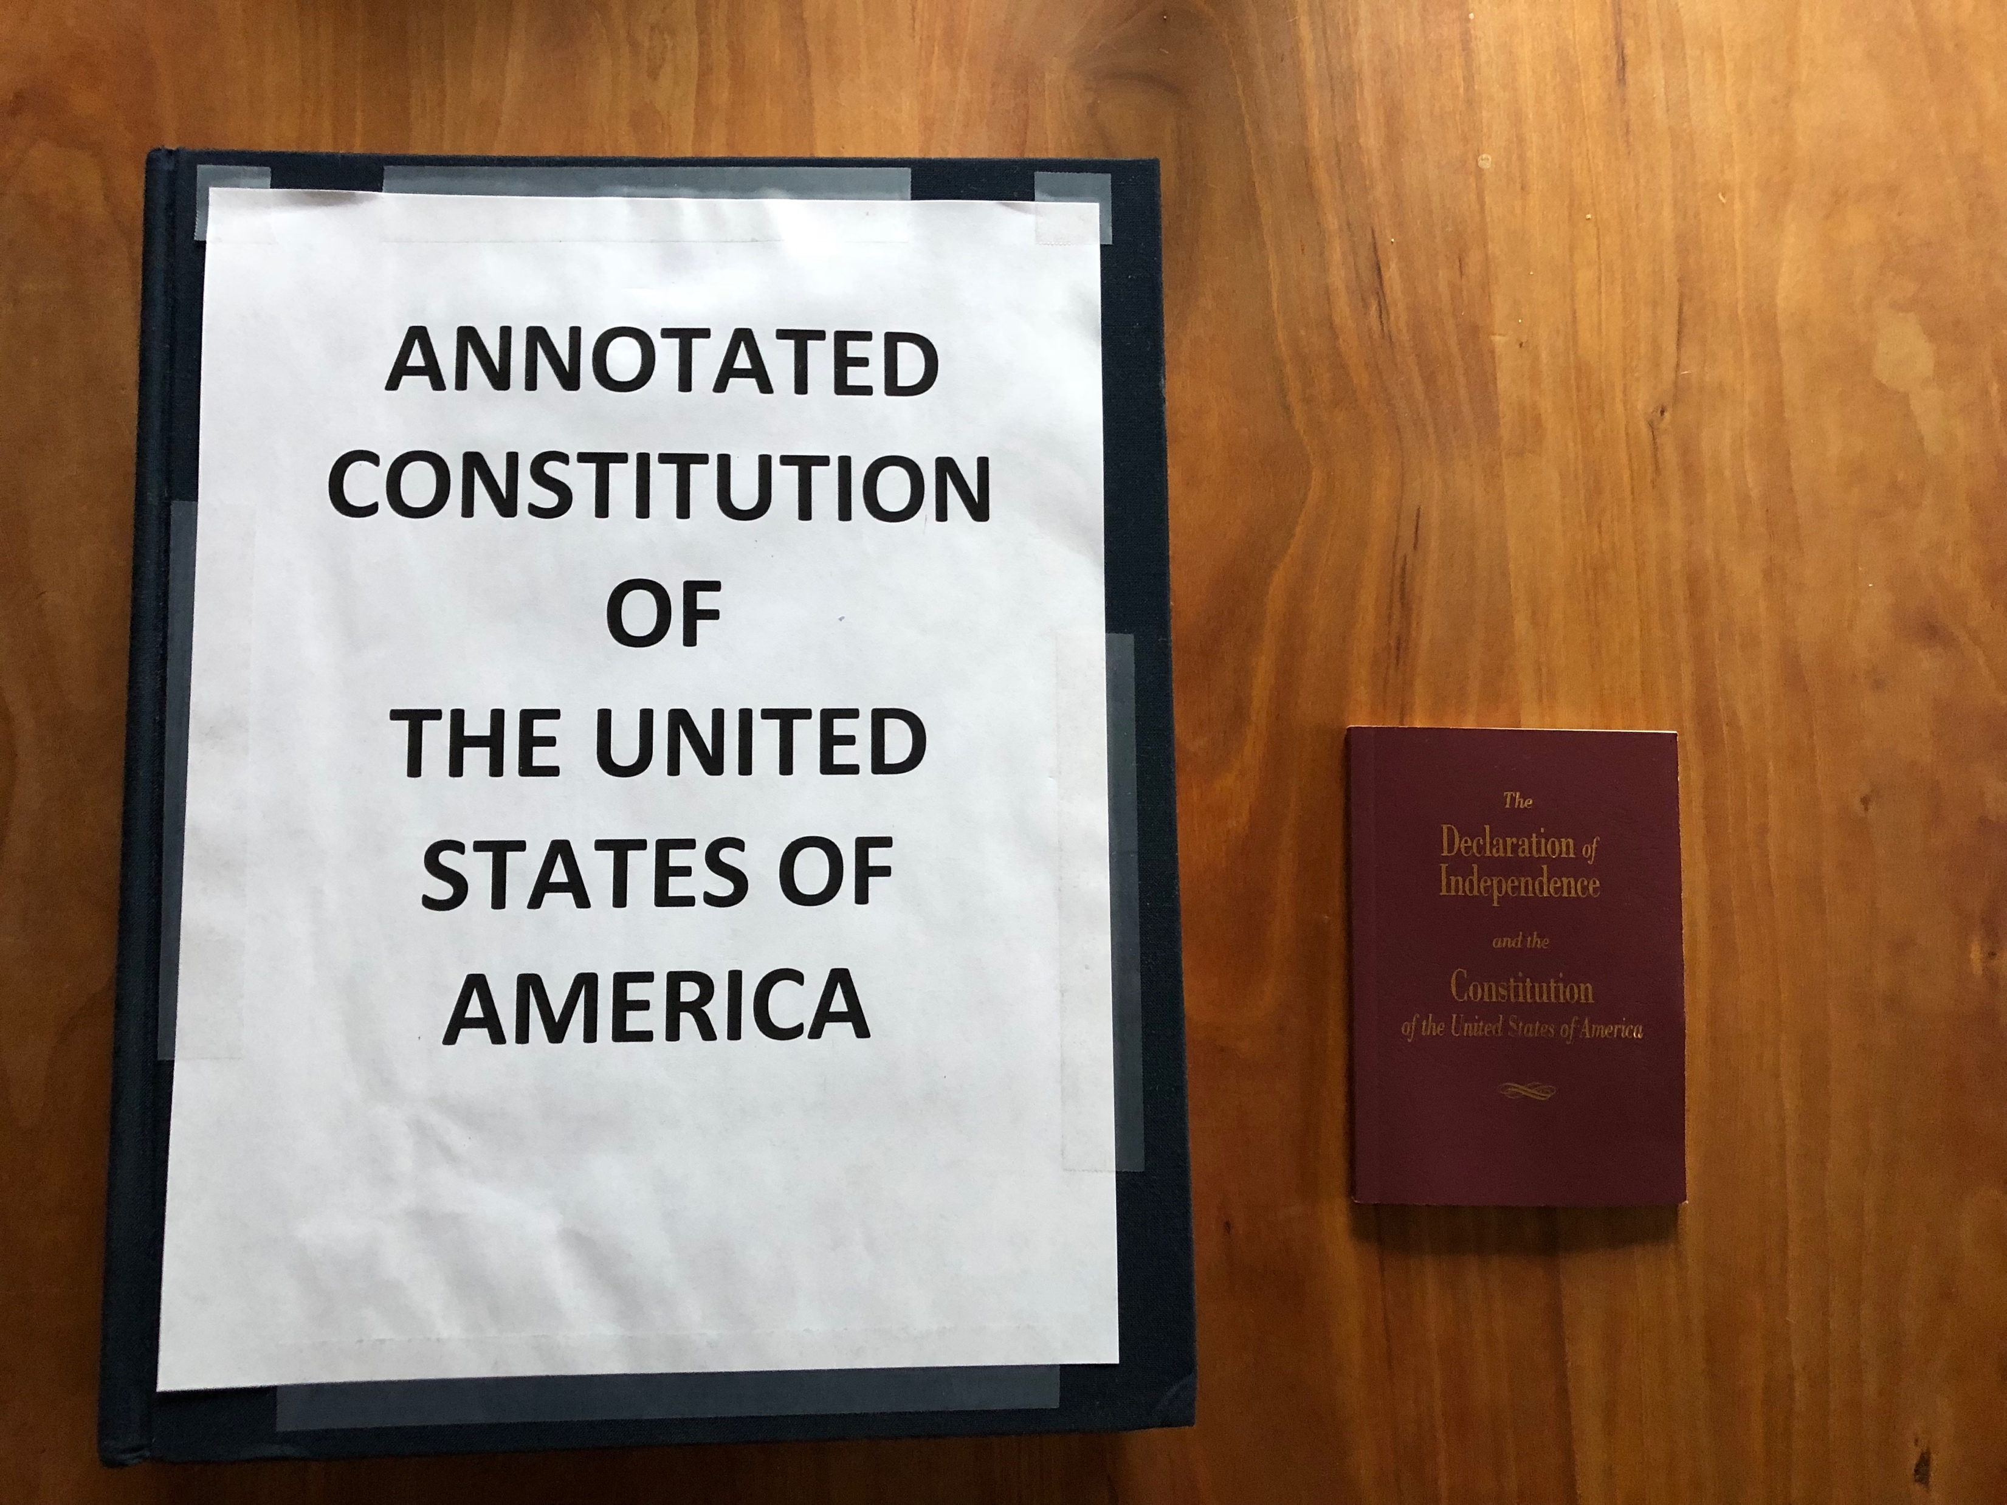
ARTICLE V MOVEMENTS MOTIVATED BY JUDICIAL INTERPRETATIONS
680 PAGES
20 PAGES
Notes:
What originated as a short, clear, understandable document has become a library of “interpretations” that only legal scholars can try to understand

